Slide 1
Customer Analytics
Lecture 1

Slide 2
Agenda
Course administration
What is testing and why is it useful?
Uncertainty and probability of making a mistake; how big should the test be?
Making smarter use of the test with targeting
Notes:
Ask questions to Anne

Slide 3


Teachers
Instructor George Knox G.Knox@tilburguniversity.edu email about: Lectures, content | Assistant Anne van der Vliet A.vdrVliet@tilburguniversity.edu email about: Assignments, administration

Slide 4
Marketing: then and now
Product-centric
Transaction-focused
Customer-centric
Relationship-focused
Customers are assets that generate profits over time
Notes:
What products can we make; focus on selling more; short term oriented on transaction
What does the customer want; To growing relationships with customers;

Slide 5
Customer lifecycle
Customer development: change in behavior over time: buying more (up-selling) or different things (cross-selling)
Customer acquisition:
how customers are “born” or first contact with the firm.
Customer retention: preventing customer “death” or churn.
Marketing is about acquiring, developing and retaining customers
Notes:
Customers go through stages in their relationship with the firm.

Slide 6
Customer analytics
Using customer data and statistical models to make business decisions:
Who should be targeted for … a marketing campaign, churn prevention, cross-selling, acquisition?
Should we do a test before we roll it out? How big?
How many subscriptions/transactions can we predict over time for a cohort of customers?
How valuable is a customer to the firm over his or her lifecycle? How does it differ across customers?

Slide 7
Lectures 1-5: Short-term analytics
Testing and Uncertainty: Why test? Quantifying uncertainty; how large should the test be?
Models for selecting customer to target: which customers should be selected for e.g., acquisition, retention, direct mailing?
Models for customer development: collaborative filtering, cross-selling
Guest lecture: Barrie Kersbergen (Bol) on Recomender systems in practice

Slide 8
Lectures 6-9: Long term analytics
How does the customer base change over time as customers drop out? Why does retention increase over time?
Customer lifetime value (CLV): who are the most valuable customers: how do you calculate the value to the firm of the customer over his or her lifecycle?
Guest lecture: Coolblue, Implementing CLV

Slide 9
Grading
Individual assignments: 30%
Computer exam (individual): 70%

Slide 10
Grading (2)
To pass the course you need:
final grade ≥ 6
exam grade ≥ 5
The assignment grade still counts if you take the resit

Slide 11
Assignments
Each lecture has an assignment
Due a week after following Sunday
Late assignments not accepted
It’s OK if you discuss with others, but all assignments are to be done individually.
Testvision software (If you have problems with part, be sure to email Anne)

Slide 12
Data sets & software
The course is organized around several data sets that illustrate an important concept.
All these examples will be “hands-on” and have an emphasis on real-time problem solving.
We’re using R this year (not SPSS as past years)
Advantages: widely used & lots of contributed software, free
Disadvantages: programming language, unpredictability of packages, updates
R notebooks in the computer lab
Notes:
not about programming

Slide 13
Readings
Book: Blattberg, Robert C., Byung-Do Kim, and Scott A. Neslin. Why Database Marketing? Springer New York, 2008. [BKN]
Articles: Other articles and material you can find on canvas under modules.

Slide 14
Weekly schedule
Lecture
Computer lab
Q&A
Everything will be given online; no in-person/offline sessions
Everything will be given live and recorded
Notes:
Anne Q&Q

Slide 15
Testing and Uncertainty

Slide 16

E-Beer
E-Beer sells beer over the Internet and currently has about 50,000 customers
A customer selects the favorite brand, pays, and within 1 hour the ordered amount of beer is delivered at the specified address
To boost sales, E-Beer developed a mailing to send to their customers.
Each mailing contains a flyer to remind customers of the offered service and a key ring with the name and web address of the company

Slide 17

Campaign costs
Each mailing costs € 1.50
Sending it to all customers would mean total costs of
$$\text{€} 1.50×50000=\text{€} 75000$$

Slide 18
Is it worth it? Do benefits > costs?
The problem is that the benefit is uncertain!

Slide 19
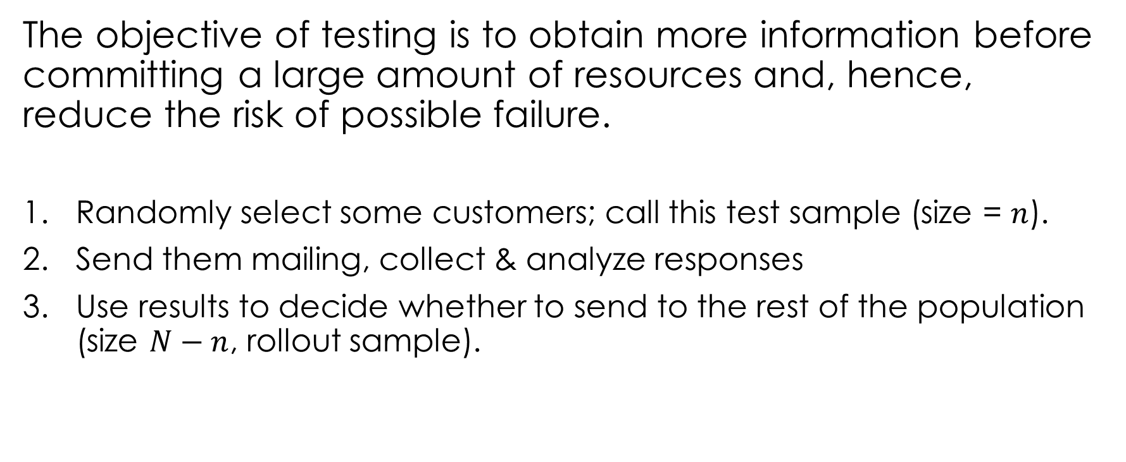


Testing
The objective of testing is to obtain more information before committing a large amount of resources and, hence, reduce the risk of possible failure.
Randomly select some customers; call this test sample (size = $n$).
Send them mailing, collect & analyze responses
Use results to decide whether to send to the rest of the population (size $N−n$, rollout sample).
Test
Sample
Rollout Sample
$$n$$
$$N−n$$
Notes:
The

Slide 20
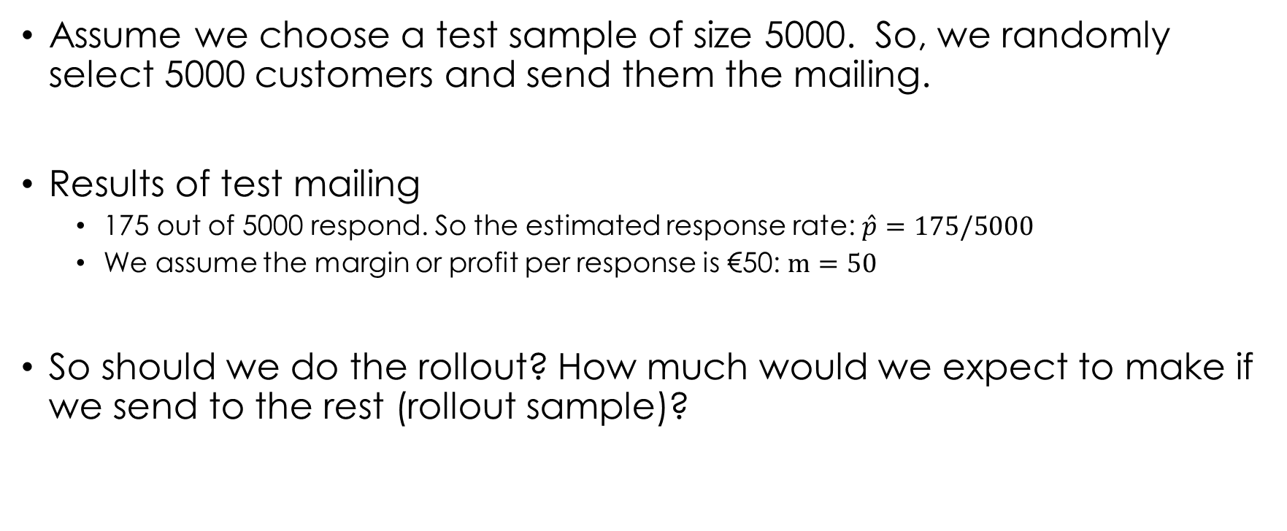
Results of test
Assume we choose a test sample of size 5000. So, we randomly select 5000 customers and send them the mailing.
Results of test mailing
175 out of 5000 respond. So the estimated response rate: $\hat{p}=175/5000$
We assume the margin or profit per response is €50: $m=50$
So should we do the rollout? How much would we expect to make if we send to the rest (rollout sample)?

Slide 21
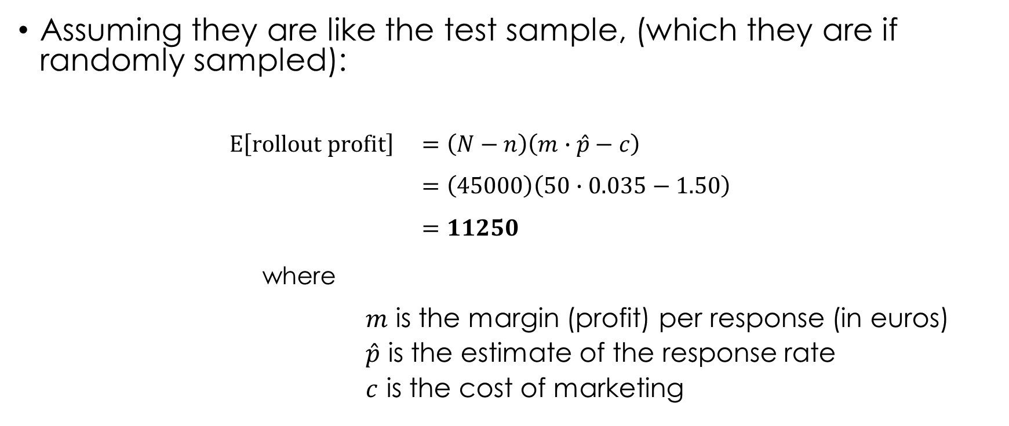
Expected rollout profits
Assuming they are like the test sample, (which they are if randomly sampled):
$$E\left[rollout profit\right] =\left(N−n\right)\left(m∙\hat{p}−c\right) \\ =\left(45000\right)\left(50∙0.035−1.50\right) \\ =11250$$
where
$m$ is the margin (profit) per response (in euros)
$\hat{p}$ is the estimate of the response rate
$c$ is the cost of marketing
Profit per customer
# customers

Slide 22
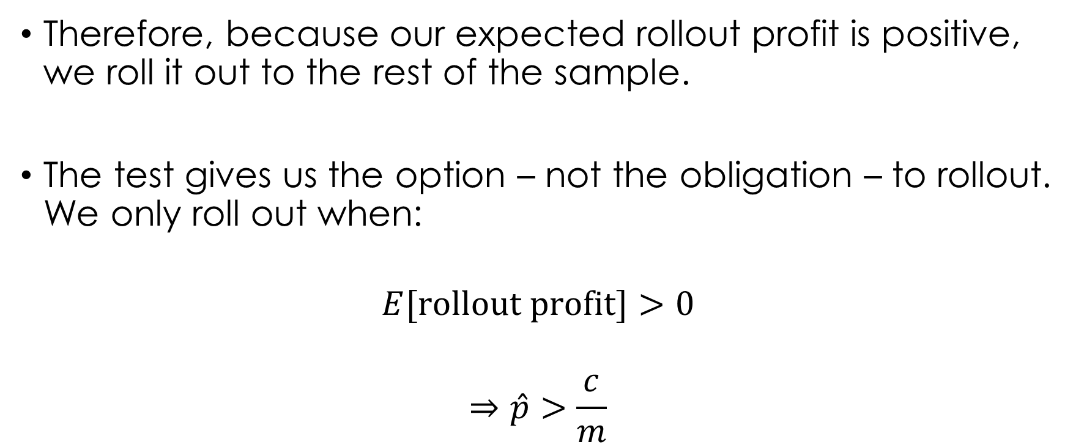
Option value
Therefore, because our expected rollout profit is positive, we roll it out to the rest of the sample.
The test gives us the option – not the obligation – to rollout. We only roll out when:
$$E[\text{rollout} \text{profit}\text{]}>0$$
$$⇒\hat{p}>\frac{c}{m}$$
in the example, what’s the threshold?

Slide 23



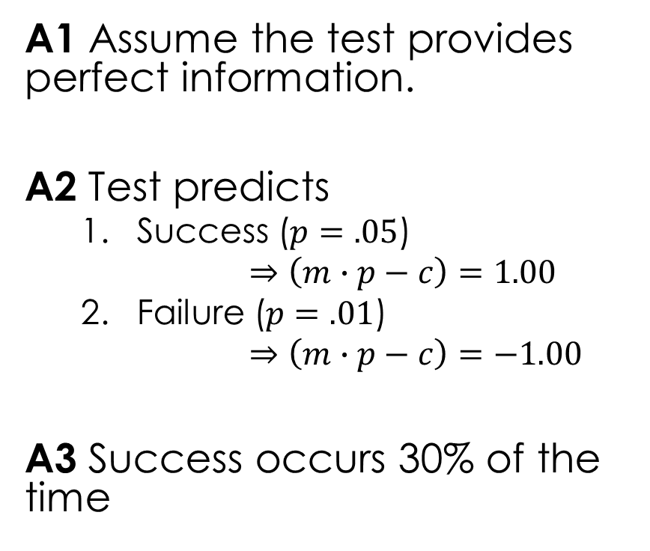


How big is the option value?
A1 Assume the test provides perfect information.
A2 Test predicts
Success ($p=.05$)
$⇒\left(m∙p−c\right)=1.00$
Failure ($p=.01$)
$⇒\left(m∙p−c\right)=−1.00$
A3 Success occurs 30% of the time
$=$ 0 (why?)
No test
Decision
mail
Success
$$= 50000$$
$$0.3$$
(test + rollout)
Test
Test
says
No mail
Failure
$$=−5000$$
$$0.7$$
(only test)
$$\text{Value} \text{of} \text{test}=0.3∙\left(50000\right)+0.7∙\left(−5000\right)−0 \\ =11500$$

Slide 24
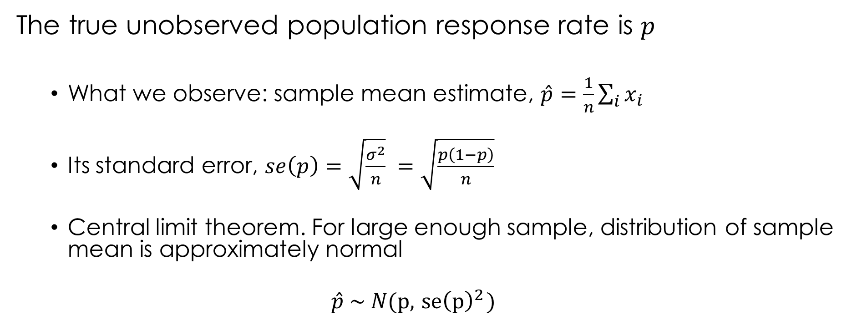
Uncertainty
The true unobserved population response rate is $p$
What we observe: sample mean estimate, $\hat{p}=\frac{1}{n}\sum_{i}{x_{i}}$
Its standard error, $se\left(p\right)=\sqrt{\frac{σ^{2}}{n}} =\sqrt{\frac{p\left(1−p\right)}{n}}$
Central limit theorem. For large enough sample, distribution of sample mean is approximately normal
$$\hat{p} \sim N(p, { se\left(p\right)}^{2})$$

Slide 25

What’s the probability we make a mistake?
$$P\left(\hat{p}<0.03\right)=.027$$

Slide 26
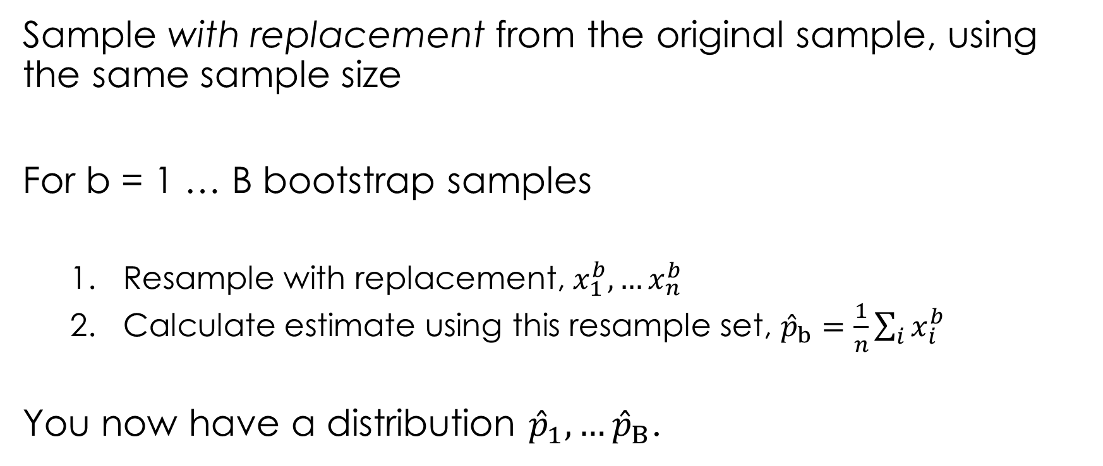
Bootstrap
Sample with replacement from the original sample, using the same sample size
For b = 1 … B bootstrap samples
Resample with replacement, $x_{1}^{b}, …x_{n}^{b}$
Calculate estimate using this resample set, ${\hat{p}}_{b}=\frac{1}{n}\sum_{i}{x_{i}^{b}}$
You now have a distribution ${\hat{p}}_{1}, …{\hat{p}}_{B}$.

Slide 27
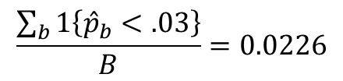
$$\frac{\sum_{b}{1\left\{{\hat{p}}_{b}<.03\right\}}}{B}=0.0226$$

Slide 28
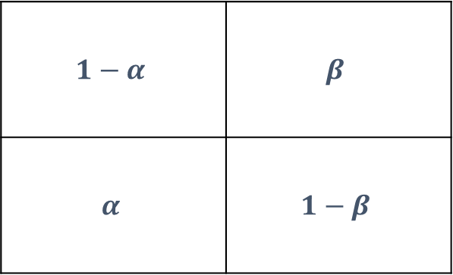
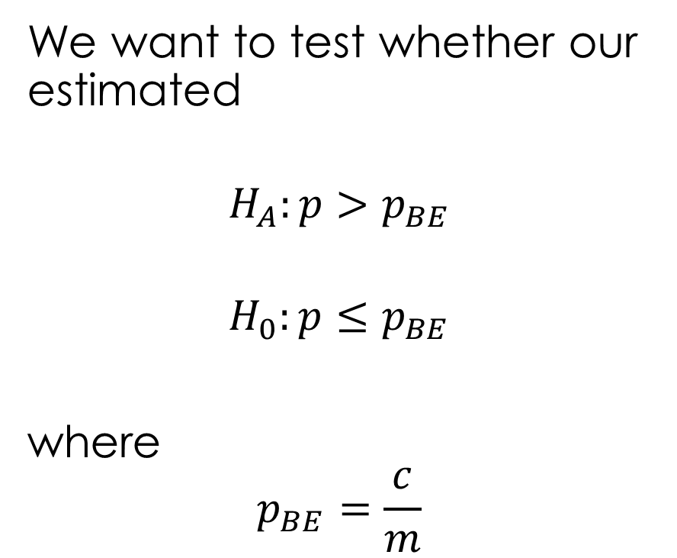


How big should the test be?
type 2 error
We want to test whether our estimated
$$H_{A}:p>p_{BE}$$
$$H_{0}:p≤p_{BE}$$
where
$$p_{BE}=\frac{c}{m}$$
Reality
$$p≤p_{BE}$$
$$p>p_{BE}$$
$$1−α$$ | $$β$$
$$α$$ | $$1−β$$
No rollout
Decision
rollout
type 1 error
power

Slide 29
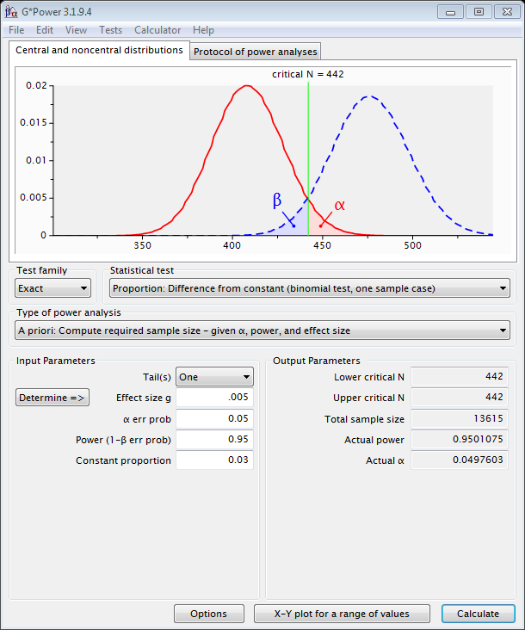
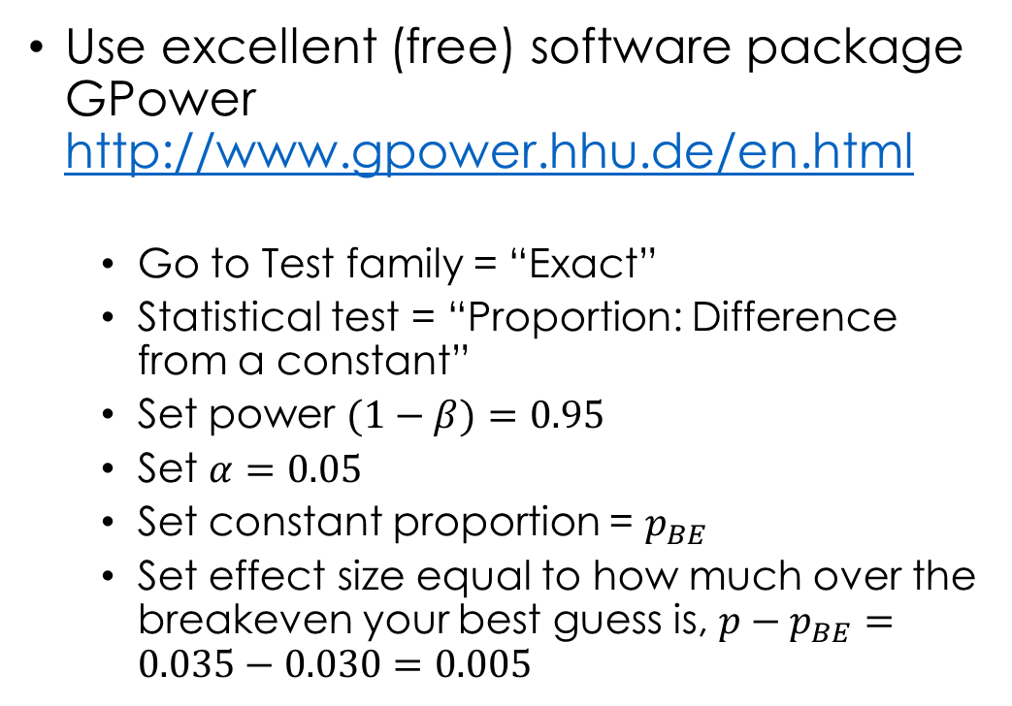
How should you determine the sample size?
Use excellent (free) software package GPower http://www.gpower.hhu.de/en.html
Go to Test family = “Exact”
Statistical test = “Proportion: Difference from a constant”
Set power $(1−β)=0.95$
Set $α=0.05$
Set constant proportion = $p_{BE}$
Set effect size equal to how much over the breakeven your best guess is, ${p−p}_{BE}=0.035−0.030=0.005$

Slide 30
Making smarter use of the test results
So far, we’ve considered an “all or nothing” approach
What if we used the test to identify profitable groups, and target mailing to them?
Test
Sample
Targeted Rollout
Sample (sent)
Untargeted Rollout
Sample (not sent)

Slide 31
Data for the groups
Of course we can build a model to select customers on the basis of many variables! Better predictions.
Demographics: gender, ethnicity, age, income, family size, occupation, marital status, education, homeowner or renter, length of residence (typically available for prospects)
Transaction data: past purchases, amounts, dates, discounts, …
Marketing: past mailings, content mailings, date, costs
(Survey data, e.g. Psychographics): attitudes, interests, activities
Most common
Best but unavailable for prospects
See BKN chapter 8

Slide 32
Example: better targeting with model
Let’s say we use our test data to build a model that predicts response probability
Profit contribution per response (m) = 80.00
Each mailing costs 0.70
Rollout sample size = 1000000
See BKN chapter 8

Slide 33
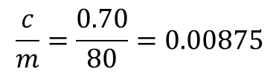
We sort them into deciles from most likely to least likely
$$\frac{c}{m}=\frac{0.70}{80}=0.00875$$

Slide 34

Targeting: select customers based on deciles
Decile | size | p | (pm - c) | profit | cum profit
1 | 100000 | 0.0300 | 1.70 | 170000 | 170000
2 | 100000 | 0.0200 | 0.90 | 90000 | 260000
3 | 100000 | 0.0140 | 0.42 | 42000 | 302000
4 | 100000 | 0.0115 | 0.22 | 22000 | 324000
5 | 100000 | 0.0100 | 0.10 | 10000 | 334000
6 | 100000 | 0.0060 | -0.22 | -22000 | 312000
7 | 100000 | 0.0040 | -0.38 | -38000 | 274000
8 | 100000 | 0.0030 | -0.46 | -46000 | 228000
9 | 100000 | 0.0010 | -0.62 | -62000 | 166000
10 | 100000 | 0.0005 | -0.66 | -66000 | 100000
$$\left(.03∗80−.70\right)=1.70$$

Slide 35
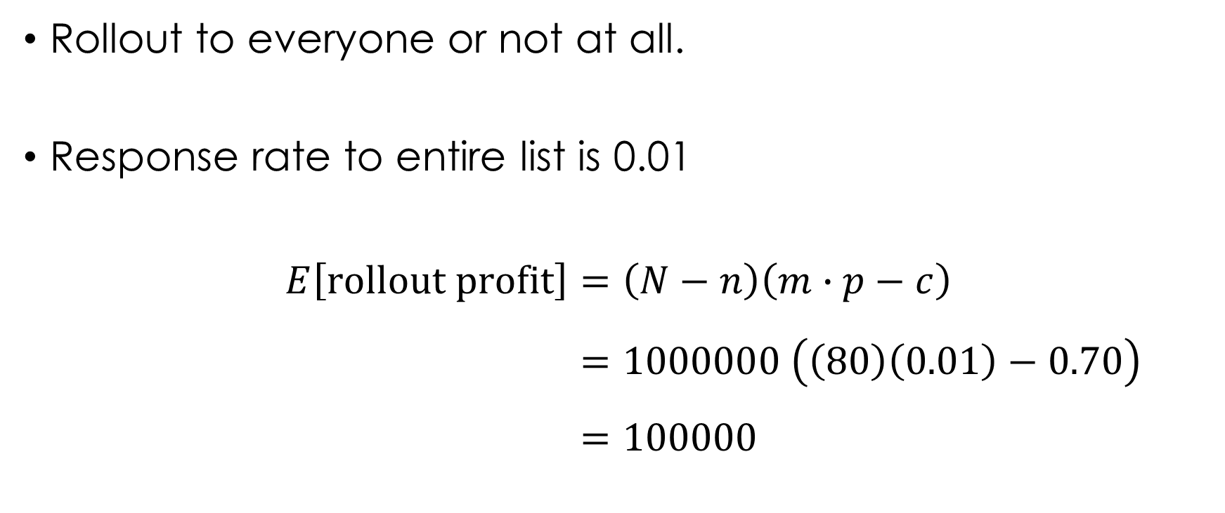
Base case: no targeting
Rollout to everyone or not at all.
Response rate to entire list is 0.01
$$E\left[\text{rollout} \text{profit}\right]=\left(N−n\right)\left(m∙p−c\right) \\ =1000000 \left(\left(80\right)\left(0.01\right)−0.70\right) \\ =100000$$

Slide 36
Summary
No targeting: mail everyone, profits = 100000
Targeting: mail top 5 deciles, profits = 334000
Cost is 500000 x 0.70 = 350000
ROI = profits/cost
Mail Top 5 ROI = 334000/350000 = 95%
Mail everyone ROI = 100000/700000 = 14%
For half the cost, three times the profit
Even if the untargeted mailing campaign would be profitable, selecting customers usually is more profitable

Slide 37
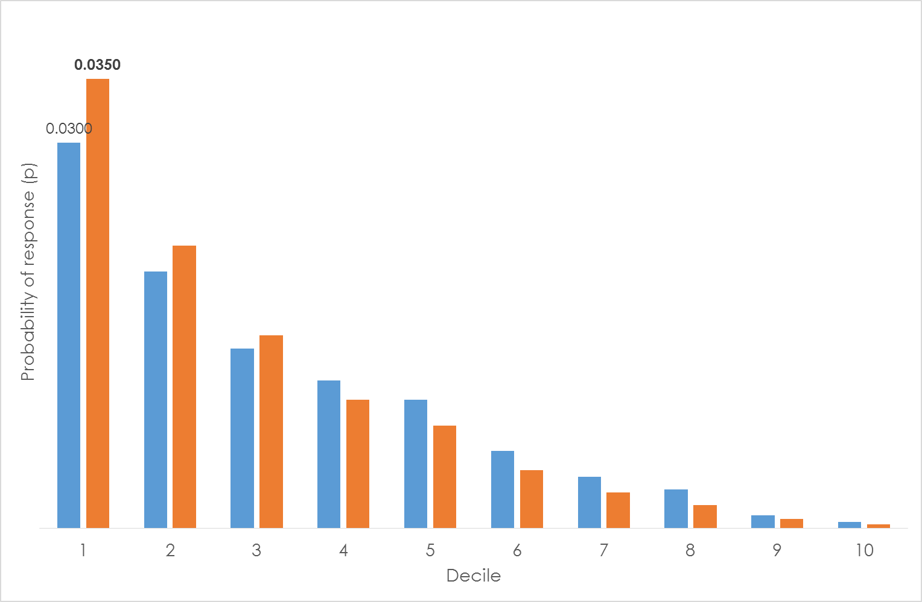
Even better predictions?
Decile | size | p | (pm - c) | profit | cum profit
1 | 100000 | 0.0350 | 2.10 | 210000 | 210000
2 | 100000 | 0.0220 | 1.06 | 106000 | 316000
3 | 100000 | 0.0150 | 0.50 | 50000 | 366000
4 | 100000 | 0.0100 | 0.10 | 10000 | 376000
5 | 100000 | 0.0080 | -0.06 | -6000 | 370000
6 | 100000 | 0.0045 | -0.34 | -34000 | 336000
7 | 100000 | 0.0028 | -0.48 | -47600 | 288400
8 | 100000 | 0.0018 | -0.56 | -55600 | 232800
9 | 100000 | 0.0007 | -0.64 | -64400 | 168400
10 | 100000 | 0.0003 | -0.68 | -67600 | 100800
ROI = 376000/280000 = 134%
Small improvements in predictions matters!

Slide 38
Conclusion
Testing resolves (some, usually not all) uncertainty about the benefit of marketing.
Testing gives the option to rollout if test results are positive
Even more value when you use it to better target
Next class: Recency-Frequency-Monetary (RFM) analysis

